Slide 1
ABDELGHAFOR’S HACKATHON
Local Library Console Management System

Slide 2
Notes about me
Name : Abdelrahman Gamal Soliman
❑ Computer Science And Engineering Engineer at Faculty of Electronic Engineering at Menofia University
❑ LinkedIn account :
www.linkedin.com/in/abdelrahman-gamal-a5b3a1244

Slide 3
Overview of the Project
Implementation of Data structure:
Implement Book as a dictionary with key is Book ID and values are the book genre, book name , book author and book availability.
Implement Members as Dictionary with key is Member ID and values are the Member name, Borrowed books by this each member and late fees form late return transactions
Implement Borrow Transaction as a dictionary to record each borrow transaction occurred. The key is Borrow Transaction ID is consist of book ID with Member ID and values are member ID, Member name, Book ID, Book name, Return Date , Borrow Date
Implement Return Transaction as a dictionary to record each Return transaction occurred. The key is Borrow Transaction ID is consist of book ID with Member ID and values are member ID, Member name, Book ID, Book name, Return Date and Late fees if exist

Slide 4
2. Implementation of Functions:
For Book’s operations:
Add Book : used to add new book to the system.
Update book : used to Update the Information of a specific book.
Remove book : used to Remove a specific book from the system.
Borrow book : used to borrow a specific book by a specific member.
Return Book : used to return a specific book by a specific member.
Print books and their IDs : used to print each book with its ID and its Genre.
Search for book : used to search about a specific book by its name and its genre.
List borrowed books : Display a list of currently borrowed books and their due dates.
List overdue books : Show books that are overdue and need to be returned.
Most popular books : Generate a list of the most frequently borrowed books.

Slide 5
2. Implementation of Functions:
2. For Member’s operations:
Register member : Register a new member to the system.
Update member : used to Update the Information of a specific member.
Remove member : Remove a member from the system.
Print members and their IDs : print each member with its ID.
Search for member : search about a specific book by its name.

Slide 6
2. Implementation of Functions:
3. For File Handling :
Load data : Load book and member data from text files at startup.
Save data : Save the current state of the catalog and member information to text files before exiting.
4. For Additional Features:
Monthly report : Display books added, books updated and which parameter updated, books removed, member added, members updated and which parameter updated, member removed, borrow transactions occurred, Return transactions occurred, all borrowed books and their return dates, all overdue books and most five common books had borrowed during each month and Display all this in the day 1 of each month after asking the user if he wants to display this information

Slide 7
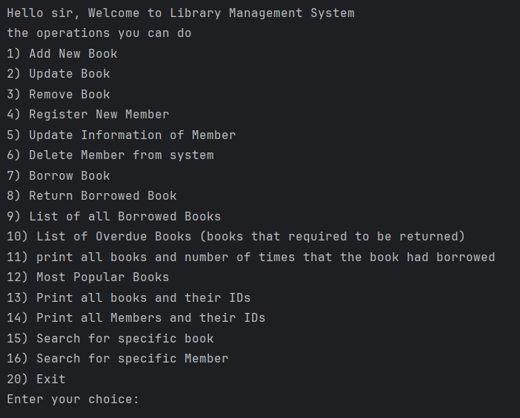
3. Implementation of User Interface:
First, check on the day of month if the day is day 1 ask the user if he wants to print monthly report. If yes , print all information about this month.
Then print all operations you can do
and their numbers and wait until the
user enters the number of operation he
wants to do

Slide 8
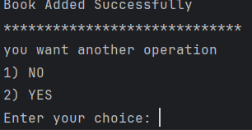
3. Implementation of User Interface:
After each operation, the system ask the user
if he wants another operation.
If the user choose NO (1) ,the system will save
the information and exit.
If the user choose YES (2) ,the system will ask the user to enter number of operation as we mentioned before
Else the system print Error Handling Message to inform the user about the error.

Slide 9
Actual Implementation of project
Implementation of Data Structure:
Book Catalog : implemented as a dictionary to record information
about each book and the key is book ID.
Book ID consist of the first two character of book genre in Uppercase and number of book in this genre (For example if the book genre is “science”
And the number is 5 so the book ID becomes “SC5”).
This way of addressing the books make the id of the book more readable and has meaning that when any human read this id can easily identify the book genre and its location and make more wide range of IDs that we can use number 1 with all book genres in the library like ( SC1 , MA1, .. So on)
And we use the two letters of book genre in uppercase to avoid depending on user input that if the user enter “Science” or “science” or any thing else , just enter book genre correctly.

Slide 10
Implementation of Data Structure:
Book Catalog : and also the values (Information recorded about each book) of book catalog dictionary are Book Genre, Book Author,
Book name, and Availability Status of the book.
2. Members : implemented as a dictionary to record information
about each member and the key is Member ID.
Member ID is also designed as the same way with book ID consist of the first two character of Member name in Uppercase and number of Member (For example if the member name is “ali” and the number is 20 so the member ID becomes “AL20”).
This makes IDs of the system is more meaningful instead of Random numbers with no meaning

Slide 11
Implementation of Data Structure:
2. Members : and also the values (Information recorded about each member) of Members dictionary are Member Name, List of books are borrowed by this member, and Late Fees if the member return any book after the return date.
3. Borrow Transaction : implemented as a dictionary to record information
about each borrow operation occurred and the key is Transaction ID.
To make Transaction ID more readable and represent the operation, I make the Transaction ID consist of book ID borrowed and member ID who want to borrow this book separated by “_” ( For example if book ID is SC1 and member ID is AL1, the Transaction ID becomes “SC1_AL1”) to make the ID easily to identify which book is borrowed and by whom.

Slide 12
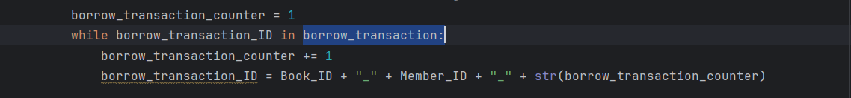
Implementation of Data Structure:
Borrow Transaction
Corner case about Transaction ID: if the same member want to borrow the same book again.
In this case we use counter and incremented when this case has happened and add another part to the ID indicating about this case. If counter equal to zero, it will mean that no repeated transaction happened
(For example “SC1_AL1_3”)
also the values (Information recorded about each borrow operation) of Borrow Transaction dictionary are Member ID, Member Name, Book ID, Book Name, Return Date, Borrow Date, Repeated borrow transaction.
Corner case:

Slide 13
Implementation of Data Structure:
4. Return Transaction: implemented as a dictionary to record information
about each return operation occurred and the key is Transaction ID.
To make Transaction ID more readable and represent the operation and should make the ID of borrow operation the same with ID of return operation, I make the Transaction ID consist of book ID borrowed and member ID who want to return this book separated by “_” ( For example if book ID is SC1 and member ID is AL1, the Transaction ID becomes “SC1_AL1”) to make the ID easily to identify which book is returned and by whom (The same way like borrow ID).
To catch the repeated borrow transaction, First, I check if the return ID exist in borrow transactions or not. If yes , do the return operation. If NO , check again after added the part of repeated transaction (the book ID and Member ID and the Repeated borrow transaction stored in borrow dictionary separated by “_” ). For example (“SC1_AL1_2”).

Slide 14
Implementation of Data Structure:
Return Transaction:
also the values (Information recorded about each return operation) of Return Transaction dictionary are Member ID, Member Name, Book ID, Book Name, Return Date, and Late fees if exist.
Catch of repeated borrow transaction

Slide 15
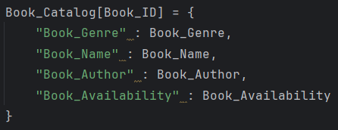
2. Implementation of Functions:
For Book’s Operations:
Add_Book(): Add new book to the system by adding book information in book catalog dictionary.
Function Steps:
Ask the user for book number and check if its integer number or not by error handling(ValueError Exception)
Ask the user for book genre
Generate the book ID (as I mentioned before) using book genre and book number
Check if this Book ID already exist or not. If exist, print warming message(custom Exception) and ask the user to try again by enter another book number. If not, continue.
Ask the user for other information (Book name , book author ,book availability)
Add book information to book catalog dictionary.
Also add information to book catalog for monthly report dictionary (for monthly Report).

Slide 16

2. Implementation of Functions:
2. For Book’s Operations:
2. Update_Book (): Update Information of a Specific book
Function Steps:
Take book number and book genre as a required parameters and book name, book author and book availability as optional parameters according to which parameter you want to update
Generate the book ID from book number and book genre.
Check which parameter is been assigned with value and then update this parameter.
3. Remove_Book (): Remove a specific book from the book catalog dictionary.
Function Steps:
Take book number and book genre as a required parameters
Generate the book ID from book number and book genre.
Check if the book ID is exist or not. If exist, remove book by using(pop(book_ID) function). If Not , print warming message that book ID doesn’t exist.

Slide 17
2. Implementation of Functions:
For Book’s Operations:
4. borrow_book(): used to control the borrow operation of a specific book by a specific member and record the borrow operation in borrow transaction dictionary.
Function Steps:
Takes book number and book genre as parameters to generate book ID and member number and member name to generate member ID and return date(“YYYY-MM-DD”)
Check if the book ID and Member ID are exist in book catalog and members dictionaries and check on the availability of book
Then subtract one from book availability and add book to the list of borrowed books belong to the member who want to borrow book
Generate the borrow transaction ID (BookID_MemberID) and care about repeated borrow transaction(same member want to borrow same book again).
Check on the return date assigned to the function, if the return date is date before today date , it is not allowed so print warming message and ask user to enter another return date.
Store all information about borrow transaction in borrow transaction dictionary (book ID , Book name , member ID , member name , return date , borrow date , repeated borrow transaction).
Additional feature: print warming message if late fees of the member bigger than 100$

Slide 18
2. Implementation of Functions:
For Book’s Operations:
5. return_book(): used to control the return operation of a specific book by a specific member and record the return operation in return transaction dictionary.
Function Steps:
Takes book number and book genre as parameters to generate book ID and member number and member name to generate member ID.
Generate the Return transaction ID (BookID_MemberID).
Check if the book ID and Member ID are exist in book catalog and members dictionaries and check if the book are borrowed before by check the existence of transaction ID in borrow transaction dictionary, if Not , check again on repeated borrow transaction, if Yes continue the return process , if Not that mean that the book hasn’t been borrowed.
remove book from the list of borrowed books belong to the member who want to return book and check on the today date and compare with the return date stored in borrow transaction dictionary to calculate late fees if exist(assume one day with one dollor).
Store all information about borrow transaction in borrow transaction dictionary (book ID , Book name , member ID , member name , return date , borrow date , repeated borrow transaction).

Slide 19
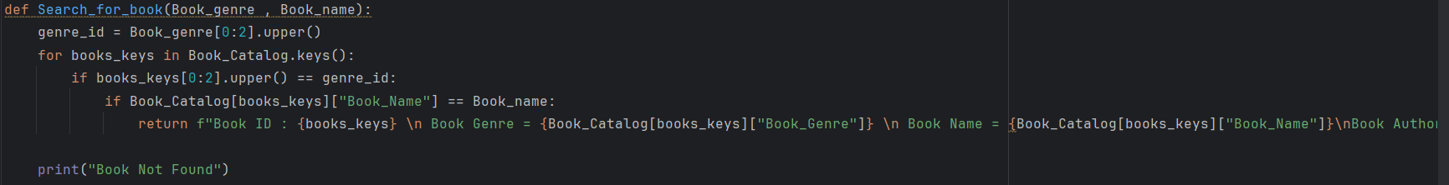
2. Implementation of Functions:
For Book’s Operations:
Print_Books_and_their_IDs(): Display all books and their IDs and their Genres
7. Search_for_book() : used to search about a specific book by its name and its genre.
Takes the book name and book genre as a parameters .
From book genre we can know first two character of book ID, so we loop on all keys start with the same genre then check on the keys which has the same book name
From this can print all information about the book (Advantages of the way we use to addressing the books which make search more easier).
List_borrowed_books(): Display all of currently borrowed books and their due dates.
Check if the book exist in borrow transaction dictionary and not exist in return transaction dictionary (this mean that book has borrowed and still not returned yet).
Check if the return transaction dictionary empty, print all borrowed books.

Slide 20
2. Implementation of Functions:
For Book’s Operations:
List_overdue_books (): Show books that are overdue and need to be returned.
Check if the book exist in borrow transaction dictionary and not exist in return transaction dictionary and then check if the return date stored in borrow transaction is late and before today date.
Check if the return transaction dictionary empty, print all borrowed books that are needed to be returned by comparing between return date and today date.
10. most_popular_books ():Generate a list of the most frequently borrowed books.
It takes optional parameter that an integer number represent number of top borrowed books (For example if you pass number 5 , the function will print the top five books that had been borrowed).
If you don’t pass any parameters, the function will print all books that had been borrowed and number of times that this books had been borrowed.

Slide 21
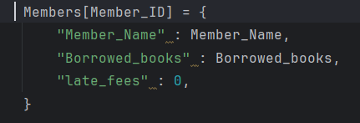
2. Implementation of Functions:
For Member’s Operations:
Register_members(): Add new member to the system by adding member information into Members dictionary.
Function Steps:
Ask the user for member number and check if its integer number or not by error handling(ValueError Exception)
Ask the user for member name
Generate the member ID (as I mentioned before) using member name and member number
Check if this member ID already exist or not. If exist, print warming message(custom Exception) and ask the user to try again by enter another book number. If not, continue.
Add book information to Members dictionary.
Also add information to member catalog for monthly report dictionary (for monthly Report).

Slide 22
2. Implementation of Functions:
2. For Member’s Operations:
2. Update_Member(): Update Information of a Specific Member.
Function Steps:
It takes member name and member number as a required parameters and add new borrowed book, return borrowed book, and late fees as optional parameters according to which parameter you want to update
Generate the member ID from member name and member number.
Check which parameter is been assigned with value and then update this parameter.
3. Remove_Member(): Remove a specific member from Members dictionary.
Function Steps:
It takes member number and member name as a required parameters
Generate the member ID from member number and member name.
Check if the member ID is exist or not. If exist, remove member by using(pop(MemberID) function). If Not , print warming message that member ID doesn’t exist.

Slide 23
2. Implementation of Functions:
2. For Member’s Operations:
4. Print_Members_and_their_IDs(): Display all Members’ names and their IDs.
5. Search_For_Member() : used to search about a specific book by its name and its genre.
It takes the member name as a parameters .
From member name we can know first two character of member ID, so we loop on all keys start with the same name then check on the keys which has the same member name.
From this can print all information about the member (Advantages of the way we use to address the members which make search more easier).

Slide 24
Implementation of File Handling:
The project has 4 main files:
Book_File_Management.txt : to record all information about book (stored in book catalog dictionary).
Member_File_Management.txt : to record all information about members (stored in Members dictionary).
Borrow_Transactions.txt : to store all information about each borrow operation occurred (stored in borrow transaction dictionary).
Return_Transactions.txt : to store all information about each Return operation occurred (stored in Return transaction dictionary).
And the project has another folder that has 8 files to store all information needed in monthly report (Additional Features).
Book_for_monthly_report.txt
Book_removed_for_monthly_report.txt
Book_updated_for_monthly_report.txt
Members_for_monthly_report.txt
Members_removed_for_monthly_report.txt
Members_updated_for_monthly_report.txt
Borrow_transaction_for_monthly_report.txt
Return_transaction_for_monthly_report.txt

Slide 25
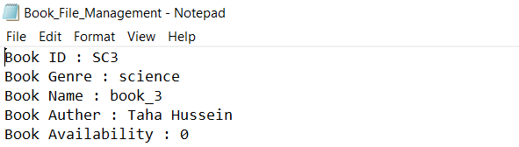
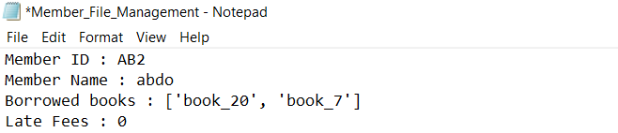
Implementation of File Handling:
Save_Data(): Save the current state of the catalog, member, borrow and return transactions information to text files before exiting.
Book_File_Management.txt : to make the data readable for the human while it is storing in the file we design the save data function to store data in this structure
Member_File_Management.txt : as the book file management, I used the same structure to store data to make data easily to read.

Slide 26
Implementation of File Handling:
Save_Data(): Save the current state of the catalog, member, borrow and return transactions information to text files before exiting.
Borrow_Transactions.txt : used to store all information about all borrowed operation occurred, to make data easy to read from file and also load easily from file into the dictionary, I designed the save data to store each operation in each line with this shape(operation ID : operation values)
5. Return_Transactions.txt : used to store all information about all returned operation occurred, to make data easy to read from file and also load easily from file into the dictionary, I designed the save data to store each operation in each line with this shape (operation ID : operation values) as the same way like borrow transaction

Slide 27
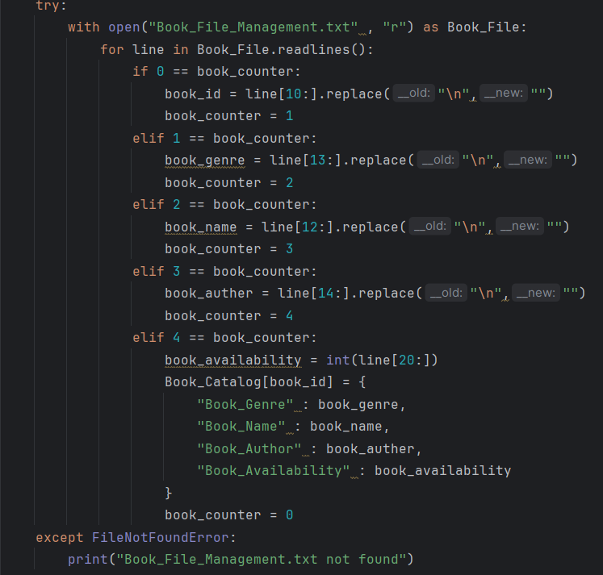
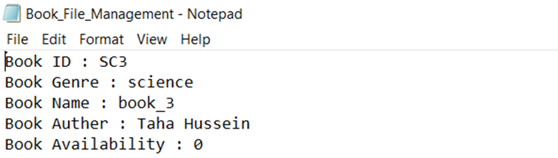
Implementation of File Handling:
Load_Data(): Load book, member, borrow and return operation data from text files at startup.
Book_File_Management.txt :
because of the structure of data in the file,
I use the indexing method of list
(each line of file is considered a list of strings)
to extract the important information data
that I need.
book counter used to identify the
Line in the file

Slide 28
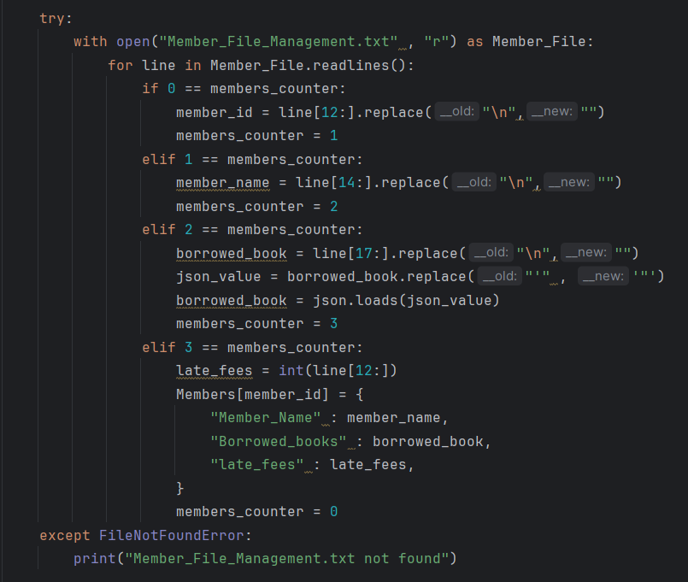
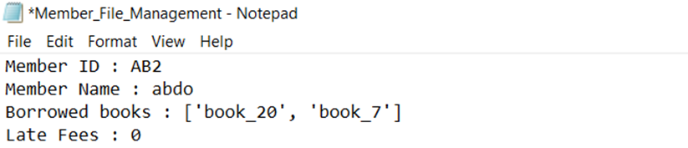
Implementation of File Handling:
Load_Data(): Load book, member, borrow and return operation data from text files at startup.
Member_File_Management.txt :
as the book file management,
I used the same way to extract data.
Member counter used to identify the
Line in the file.

Slide 29
Implementation of File Handling:
2. Load_Data(): Load book, member, borrow and return operation data from text files at startup.
3. Borrow_Transactions.txt : according the way I used to store the data in files, we use some methods to determine the key and the value.
first, we loop on the line to determine the end of key (according the way of storing after the key finished there is a space character), so we loop until find space and store result in counter which uses in indexing to successfully determine the key.
And after the key there are space semicolon and another space so the value start from (counter + 3).
After finding the value, there is a problem that the value now is a string and we need to convert it into dictionary, so we use json.loads method to convert string into dictionary data structure an store it with the key into borrow transaction dictionary.

Slide 30
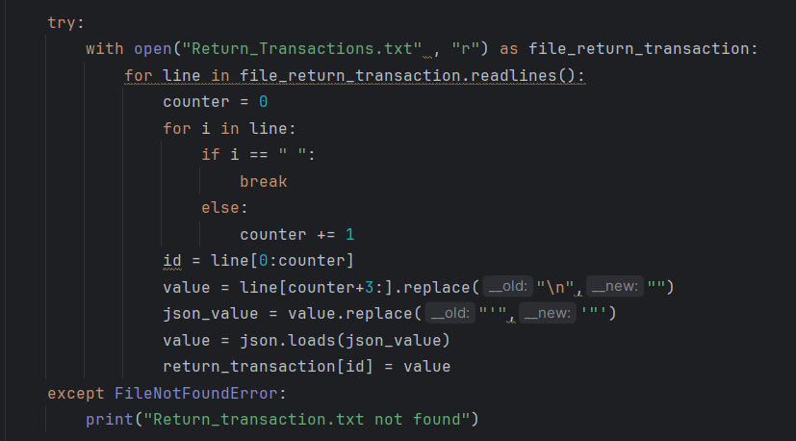
Implementation of File Handling:
2. Load_Data(): Load book, member, borrow and return operation data from text files at startup.
4. Return_Transactions.txt: to extract data, I use the same way of borrow transaction method to return information into return transaction dictionary.

Slide 31
4. Implementation of Additional Features:
Monthly_Report():
Display books added, books updated and which parameter updated, books removed, member added, members updated and which parameter updated, member removed, borrow transactions occurred, Return transactions occurred, all borrowed books and their return dates, all overdue books and most five common books had borrowed during each month and Display all this in the day 1 of each month after asking the user if he wants to display this information.
To implement this functions and print all this information of each month, I used another data structures to store this information and use 8 files to record the operations of each day until the month ended.
Book_catalog_for_monthly_report dictionary to store information about books added in the month and store the information in Book_for_monthly_report.txt file.
Book_catalog_Updated_for_monthly_report list to store the book that had updated and the parameter that had been updated and store the information in Book_Updated_for_monthly_report.txt file.
Book_catalog_removed_for_monthly_report list to store the book that had been removed from the system during the month and store the information in Book_Removed_for_monthly_report.txt file.

Slide 32
4. Implementation of Additional Features:
Monthly_Report():
Members_for_monthly_report dictionary to store information about Members added in the month and store the information in Members_for_monthly_report.txt file.
Members_Updated_for_monthly_report list to store the Member that had updated and the parameter that had been updated and store the information in Members_Updated_for_monthly_report.txt file.
Members_removed_for_monthly_report list to store the book that had been removed from the system during the month and store the information in Members_Removed_for_monthly_report.txt file.
Borrow_transaction_for_monthly_report dictionary to store information about each borrow transaction occurred during the month and store the information in Borrow_transaction_for_monthly_report.txt file.
Return_transaction_for_monthly_report dictionary to store information about each return transaction occurred during the month and store the information in return_transaction_for_monthly_report.txt file.

Slide 33
4. Implementation of Additional Features:
Monthly_Report():
In the day 1 of each month the User interface ask the user if he wants to print the monthly report.
If yes, the all information(books added, books updated and which parameter updated, books removed, member added, members updated and which parameter updated, member removed, borrow transactions occurred, Return transactions occurred, all borrowed books and their return dates, all overdue books and most five common books had borrowed) that stored in data structures belong to monthly report start to be printed in the console then the data structures cleared to start again store new information of the new month.
If No, nothing happened and the program continue.

Slide 34
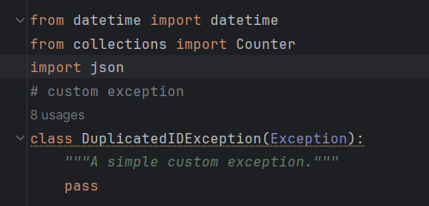
Assistance libraries:
Datetime library used to deal with dates and get today date used in borrow and return transactions.
Collections library used to in most popular to measure frequently of borrowed books.
Json library used to convert data structures from string into actual data structure that used during load the data from files.
An inheritance DuplicatedIDException class inherit from exception class that represent Custom exception which it is raised if any Duplicated ID used.

